Slide 1
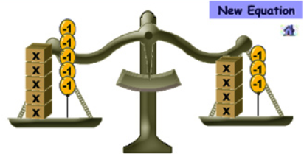
Micro-Teaching Assignment: Expressions and Equations
Jaspreet Sandha & Karima Fuentes
ESCN Secondary Math Team

Slide 2
CCSS Lesson on Equations and Expressions
MARS Concept Development Lesson:
Laws of Arithmetic

Slide 3
Common Core Standards
6.EE.1
Write and evaluate numerical expressions involving whole-number exponents
6.G
Find the area of right triangles, other triangles, special quadrilaterals, and polygons by composing into rectangles or decomposing into triangles and other shapes; apply these techniques in the context of solving real-world and mathematical problems.
Notes:
Review the standards

Slide 4
Common Core Standards
6.EE.1
Write and evaluate numerical expressions involving whole-number exponents
6.G
Find the area of right triangles, other triangles, special quadrilaterals, and polygons by composing into rectangles or decomposing into triangles and other shapes; apply these techniques in the context of solving real-world and mathematical problems.
Notes:
Emphsis for geometry the lesson will be focusing on the yellow.

Slide 5
Essential Questions
How can you apply the properties of operations to generate equivalent expressions?

Slide 6
Curriculum Map and Textbook Connections
Unit 3 in the Curriculum Map
Chapter 6 in California Math
Key Vocabulary
Expression
Evaluate
Terms
Math Practices
1, 3, 4, 6
Resources
Laws of Arithmetic: http://map.mathshell.org/materials/download.php?fileid=1358
Lesson 2
Pages 441 - 448
Math Practices
1, 4
Resources
Online Video: Amanda, Noah, and Elisa in Science Center
Virtual Manipulative: Algebra Tiles

Slide 7
Lesson Outline
Video: Amanda, Noah, and Elisa in Science Center
Vocabulary
Virtual Manipulatives: Algebra Tiles
Mars Task: Laws of Arithmetic
Independent Practice
Notes:
Video: Amanda, Noah, and Elisa in Science Center
Shown in beginning of the unit to hook kids in.
Provides a problem that will be solved at the end of the unit.
Helps students make a connection to Expression
Vocabulary
Frontload key vocabulary
Use of Foldable
Virtual Manipulatives: Algebra Tiles
To help to develop the concept of evaluating expression
Provides a visual model using area
Mars Task: Laws of Arithmetic
Pre-Assessment
Matching Activity
Post Assessment
Independent Practice
Homework
H.O.T Problems
Extra Practice
Smarter Balance

Slide 8
Video: Amanda, Noah, and Elisa in Science Center

Slide 9
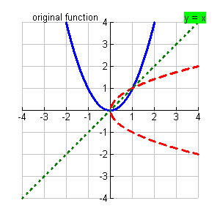
Vocabulary: Support Understanding Academic Language – Layered Book

Slide 10
Virtual Manipulatives

Slide 11
Laws of Arithmetic
Give each student a mini-whiteboard, a pen, and eraser. Ask students to write an expression that shows the calculation of area of the compound shape.

Slide 12
During the Lesson Compound Area Diagram
4 5
Area A
1
Which compound area diagram represents the expression:
5 + 4 x 2?
2
4 5
1
Area B
2
5 4
1
Area C
2

Slide 13
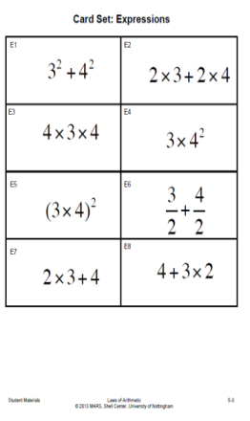
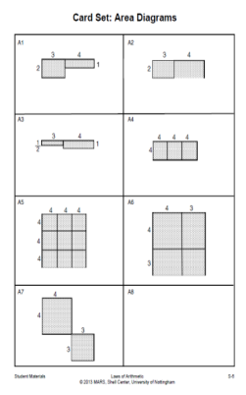
During the Lesson:
Matching Expressions to Area Diagram
1
2
Groups of 2 or 3 students will take turns to find cards that match.
Able to agree on and explain the placement of every card.
For each area card find at least two expressions cards. Use a blank card if there is no suitable card.
3
4
Stick the matched cards onto the poster paper writing any relevant calculations and explanations next to the cards.

Slide 14
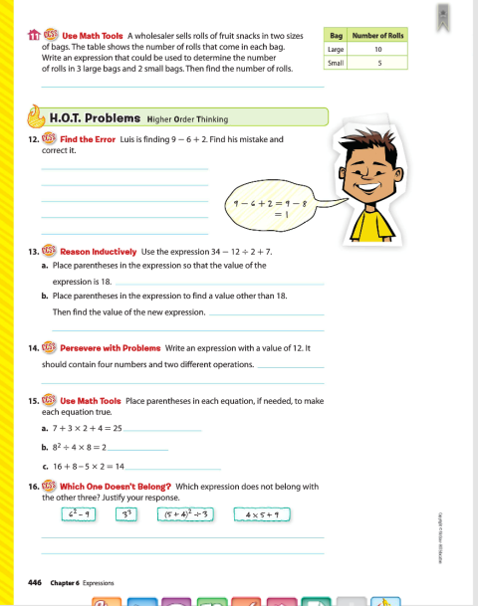
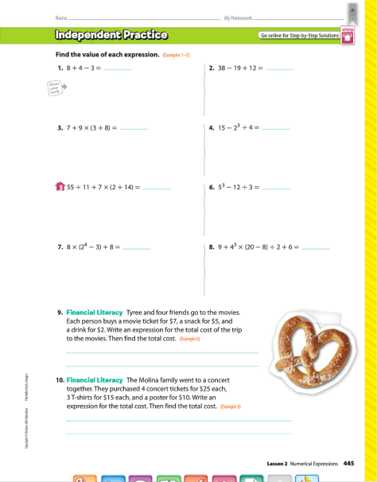
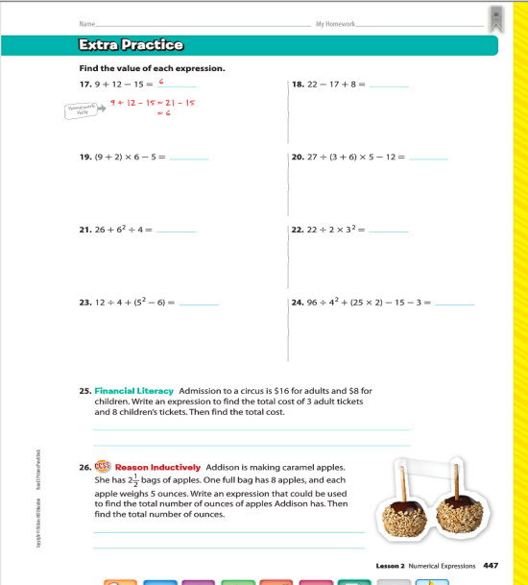
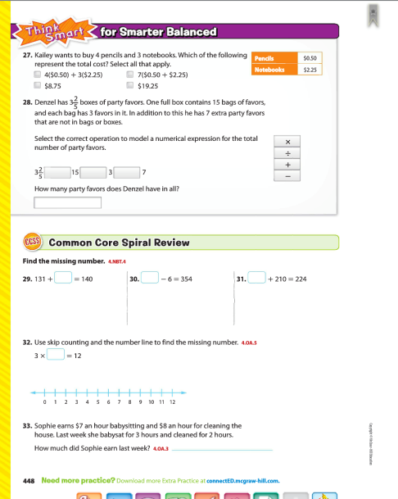
Independent Practice
Homework
CA Math, Page 445, problems 1-10
HOT Problems (Higher Order Thinking)
Page 446, problems 12-16
Extra Practice
Page 447, problems 17-26
Smarter Balanced Practice
Page 448, problems 27–28

Slide 15
Differentiation
English Learners (ELs)
Provide visuals:
Foldable for Vocabulary
Area model
Provide virtual or tangible algebra tiles
Provide sentence starter or frames
Students with Disabilities (SWD)
Provide fewer problems
Provide virtual or tangible algebra tiles
Give them more time to complete the assignment
Gifted and Talented Education (GATE)
Create a visual to match the expression
During the Laws of Arithmetic:
Give students incomplete matching sets
Create a real world context to match the different sets
Notes:
English Learners (ELs)
Provide visuals:
Foldable for Vocabulary should contain visuals of that a word is and is not.
Virtual Manipulatives allow students gain “hands on experience.”
Laws of Arithmetic provide the use of the area model to help conceptual develop expressions
Provide them with access to virtual or tangible algebra tiles during the Laws of arithmetic matching activity
Provide sentence starter or frames
Students with Disabilities (SWD)
In Laws of arithmetic matching activity, provide them with few sets they will have to match.
Provide them with access to virtual or tangible algebra tiles during the Laws of arithmetic matching activity
Give them more time to complete the assignments
Assign fewer homework problems
Gifted and Talented Education (GATE)
Provide students with and expression and have them create a visual to match the expression.
During the Laws of Arithmetic:
Give students incomplete matching sets, so they have to create the missing pieces.
Have them create a real world context to match the different sets

